Slide 1

Business Analytics and Prediction
Guo Moyi, Guo Qiying, Jin Dongni, Li Jianlong, Lyu Xiaoqi, Sun Yuting, Wen Weikang, Xiao Peiyu
2020-9-19
This report aims to provide banks with solutions to detect loan default users, taking into account that different banks may use different language environments. Using the historical loan default data provided by Nanyang Technological University, after preprocessing the data, use R and python to construct a logistic regression model and a decision tree model respectively, and use the model to predict the loaner's default situation. Based on the test results of our models, the highest prediction accuracy can reach 97.37%, and the lowest loan default rate can reach 0.19%.

Slide 2
Introduction····························3
Literature Review·······················4
Methodology···························5-7
Model································8-36
Logistic Regression in R··················8-15
Decision Tree in R·······················16-21
Decision Tree in Python··················22-27
Logistic Regression in Python············28-36
Result·································37
Discussion·····························38
Conclusion·····························39
References·····························40
Appendices··························41-43
Content

Slide 3
Introduction
The amount of loan defaults in October has steadily increased y-o-y within three years, higher than expected by major international banks[1].
The development of the digital economy under the impact of COVID-19 will increase the volume of loans by USD 2.1trn [2].
Some governments (e.g. the Italian government) hope to stimulate the economy through lending [3]. These actions make banks and governments face greater risk of loan default [4].
This report will use R and Python to build models for predicting the default of the lender, including data cleaning and exploration, model training, prediction, evaluation, and visualization.
Notes:
Loans have always been one of the main businesses of banks, who make profits by setting loan interest rates. But for a long time, loan defaults have been an issue for banks. Although banks collect a large amount of personal information for judgment when lending or credit card approval, according to a 2017 equity research by Barclays Bank [1], the amount of loan defaults in October has steadily increased y-o-y within three years. Despite the slowdown in growth, the amount of defaults is still higher than expected by major international banks. Under the COVID-19 epidemic, the global economic has been experiencing a depression, which affected the economic environment and fiscal policies. Banks tend to increase the amount of lending to ensure profitability, specifically, the development of the digital economy under the influence of the epidemic will increase the volume of loans to people and businesses by USD 2.1trn [2]. Some governments, such as the Italian government, also hope to stimulate the economy through lending [3]. These actions make banks and governments face greater risk of loan default [4]. With the development of artificial intelligence technology, data analysis and machine learning have become important tools in the field of financial risk control. This report will use R and Python to build models for predicting the default of the lender, including data cleaning and exploration, model training, prediction, evaluation, and visualization.

Slide 4
Literature Review
Decision tree and regression models are common analysis methods.
Simultaneous use of decision trees and linear regression can measure the impact of social factors (e.g. house price fluctuations) on student loan default [5].
Evaluate companies and determine the investability of assets, see [6, 7]. The accuracy is able to 99% based on the data used [7].
Notes:
In financial field, decision tree and regression models are common analysis methods. Because decision trees have strong universality, they are widely used in attribution analysis and classification. Regression models (linear regression and nonlinear regression) are also commonly used analysis models. In the study of student loan default, the simultaneous use of decision trees and linear regression can measure the impact of social factors (such as house price fluctuations) on student loan default from multiple dimensions, see [5]. In financial analysis, scholars use decision trees and logistic regression models to value companies and determine the investability of assets, see [6, 7]. The accuracy is able to 99% based on the data used[7].

Slide 5
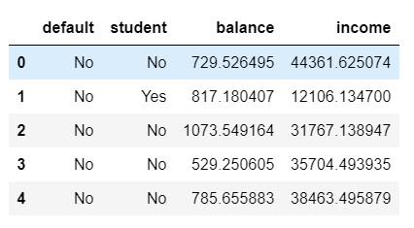
Methodology - Data
Banks are concerned about the client‘s inability to repay the loan left the bank facing losses. They need to understand what characteristics users are at risk of defaulting on their loans. In this report, a loan default dataset is used which is a historical dataset from Nanyang Technological University where each row represents one client (10000*4). The data is relatively easy to understand. Typically, strengthening risk control when lending is the best way to reduce the number of clients defaulting on loans, so the focus of this analysis is to predict who is 'risky' for the bank.
The dataset includes information about:
Income - monthly income of borrower;
Balance - the amount of money deposited in the bank of the borrower;
Student - if the borrower is a student;
Default - if the borrower defaults on a loan.
Information above is stored in the file 'LoanDefault.csv' (Table 1).
Table 1:

Slide 6
Methodology – Decision Tree
As an supervised learning model, decision tree builds classification or regression models [7, 8] in the form of a tree structure. It breaks down a dataset into smaller and smaller subsets while at the same time an associated decision tree is incrementally developed. The final result is a tree with decision nodes and leaf nodes. A decision node has two or more branches. Leaf node represents a classification or decision. The topmost decision node in a tree which corresponds to the best predictor called root node.
Our consideration of selecting decision tree for modeling is while ensuring high accuracy, it can handle both categorical and numerical data, which fit our dataset; decision tree owns a comprehensive structure that is convenient for readers to understand. However, for required dataset, it may time-consuming when facing continuous attributes, and the algorithm accuracy could be unstable [9].
Python packages needed for decision tree:
matplotlib.pyplot as plt, pandas as pd, pylab as pl, numpy as np, sklearn.tree – DecisionTreeClassifier, sklearn -preprocessing, sklearn.model_selection - train_test_split, sklearn – metrics, sklearn.externals.six – StringIO, pydotplus, matplotlib.image as mpimg, sklearn – tree, sklearn.metrics - confusion_matrix
R packages needed for decision tree:
rpart, rpart.plot, caTools

Slide 7
Methodology – Logistic Regression
While Linear Regression is suited for estimating continuous values, it is not the best tool for predicting the class of an observed data point. In order to classify, we use Logistic Regression on what would be the most probable class given variables. For this, Logistic Regression is right useful when our observed y is categorical since Logistic regression fits a special s-shaped curve by taking the linear regression and transforming the numeric estimate into a probability.
Our consideration of selecting logistic regression for modeling is it is widely used in financial risk management and the implementation is relatively simple. However, in terms of selected dataset, the algorithm cannot handle unstructured data, which must be converted.
For this report:
Python packages needed for logistic regression:
statsmodels.api as sm, pandas as pd, pylab as pl, numpy as np, scipy.optimize as opt, sklearn – preprocessing, matplotlib.pyplot as plt, sklearn.model_selection - train_test_split, sklearn.linear_model – LogisticRegression, sklearn.metrics - classification_report, confusion_matrix, itertools, sklearn - metrics, cross_validation, sklearn.linear_model – LogisticRegressionCV, sklearn.model_selection - cross_val_predict
R packages needed for logistic regression:
data.table, caTools

Slide 8
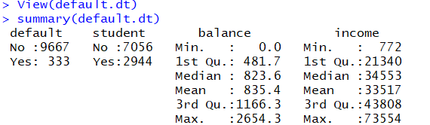
Model – Logistic Regression in R
Pre-processing
We can see some statistics and analysis on the dataset. There are 333 items belong to default and 9667 of them not belong to default. In the data, there are 2944 have the student attribute while 7056 don’t belong to student. There are many items that have no balance while the maximum balance is 2654.3 dollars and with a mean 835.4 dollars and median 823.6 dollars. The income varies a lot. The maximum is 73554 while the minimum is 772. Split the dataset into train and test set.

Slide 9
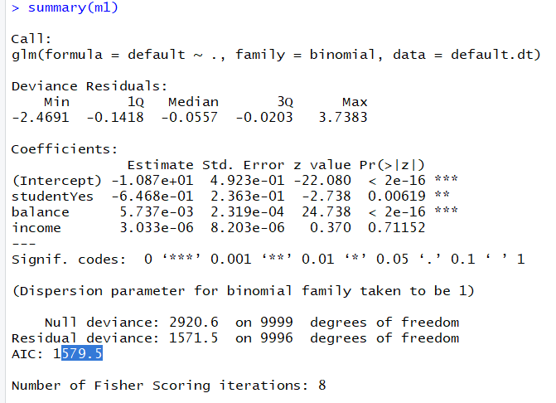
Model – Logistic Regression in R
Modeling
Obtain a regression function from above, but through the analysis we can witness that the model is still needed to be improved since the income variable has a relatively high significant level and the corresponding p value is too large.

Slide 10
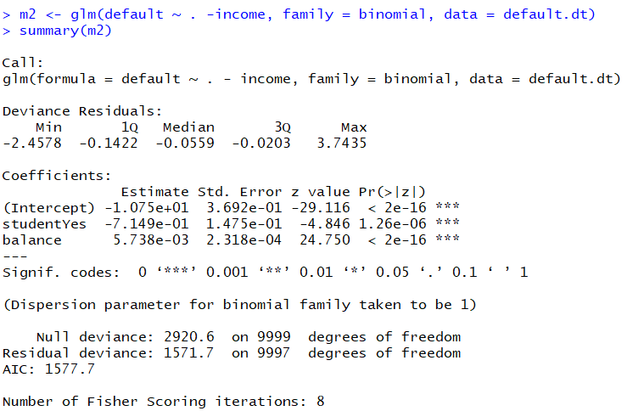
Model – Logistic Regression in R
Modeling
We eliminated the income variable and get a new multiple regression function with satisfactory p values as well as the improvement of AIC value:
Default = -10.75 - 0.7149(studentYes) + 0.005738(balance)

Slide 11
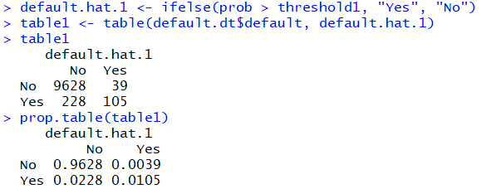
Model – Logistic Regression in R
Evaluation
Set threshold as 0.2. The matrix shows that the company will lose 228 pay back of loans and 39 customers. Such condition is harmful for the business’ further development since it lacks accuracy and has too much loss.

Slide 12
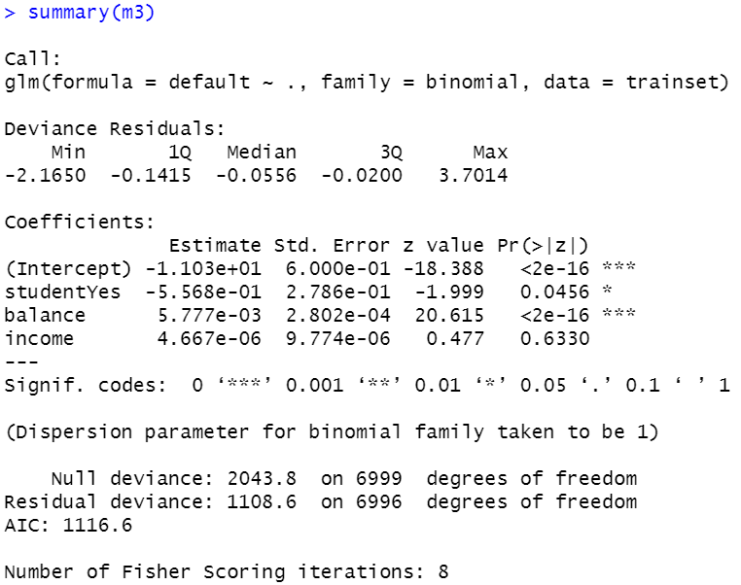
Model – Logistic Regression in R
Modeling
We use the training data set to obtain a regression analysis. From above we can see the similar result that we need to eliminate the income attribute.

Slide 13
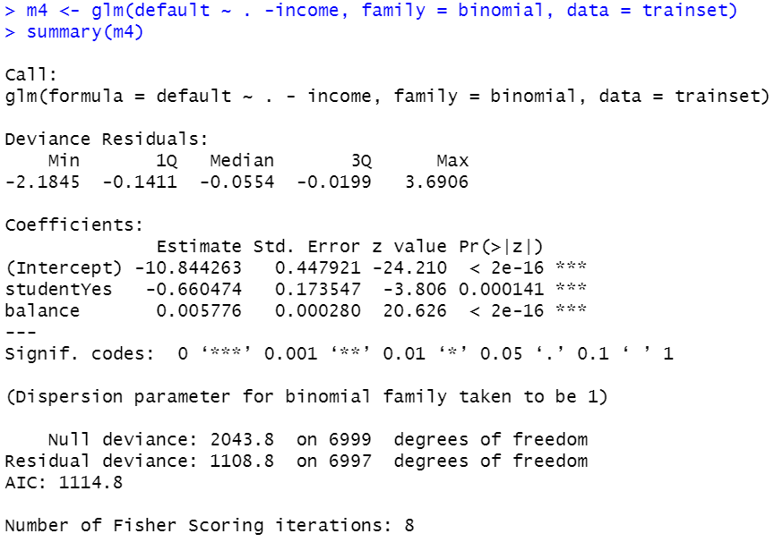
Model – Logistic Regression in R
Modeling
After eliminating the income, we obtain the regression analysis on the rest of two attributes with a better AIC value.

Slide 14
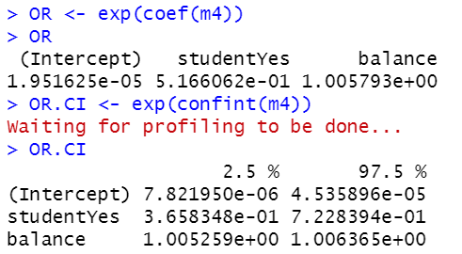
Model – Logistic Regression in R
Modeling
We generated the coefficient and the confident interval of the former regression model which the income has been eliminated.

Slide 15
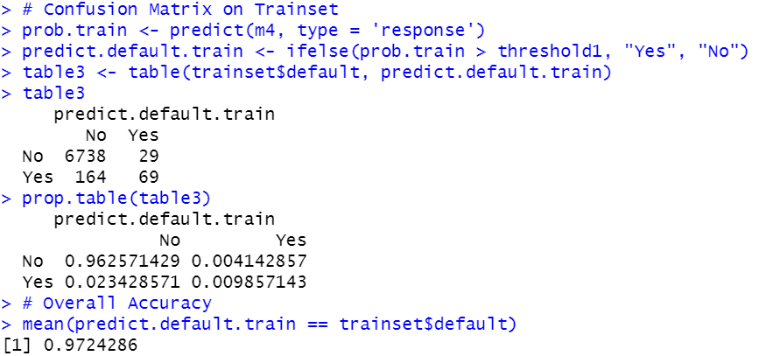
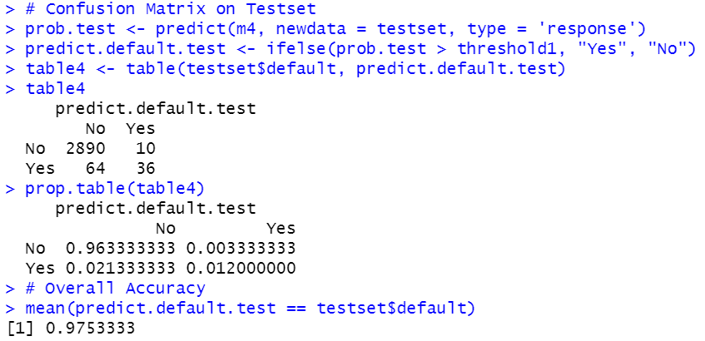
Model – Logistic Regression in R
Evaluation
In the training data set, the result of the confusion matrix seems better. The accuracy has improved but one shortcoming is that the company would still suffer from some loss.
Here we used the data in the m4 where the income has been eliminated. We can observe that the general condition is the best among the analysis before. The confusion matrix has increased its accuracy a lot and therefore the predict values are more reliable. There are fewer cases that the company will lose money from loan pay back as well as lose its customers. The overall accuracy is fulfilled.

Slide 16
Model – Decision Tree in R
Pre-processing
We can see some statistics and analysis on the dataset. There are 333 items belong to default and 9667 of them not belong to default. In the data, there are 2944 have the student attribute while 7056 don’t belong to student. There are many items that have no balance while the maximum balance is 2654.3 dollars and with a mean 835.4 dollars and median 823.6 dollars. The income varies a lot. The maximum is 73554 while the minimum is 772.

Slide 17
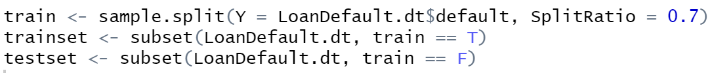
Model – Decision Tree in R
Train Test Split
Split the dataset into train and test set:

Slide 18
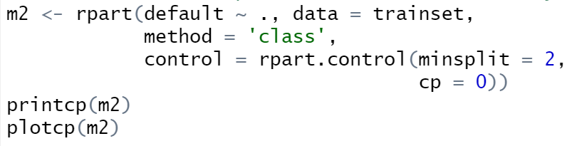
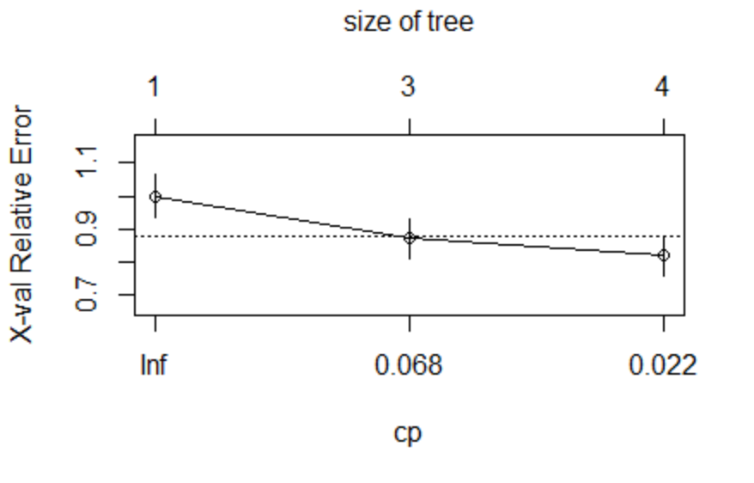
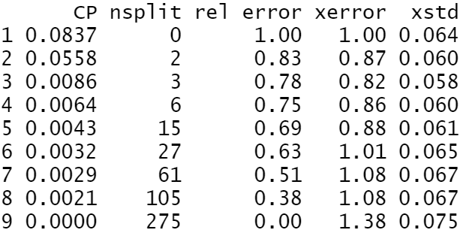
Model – Decision Tree in R
Modeling
Find the optimal complexity parameter (cp with minimum xerror):

Slide 19
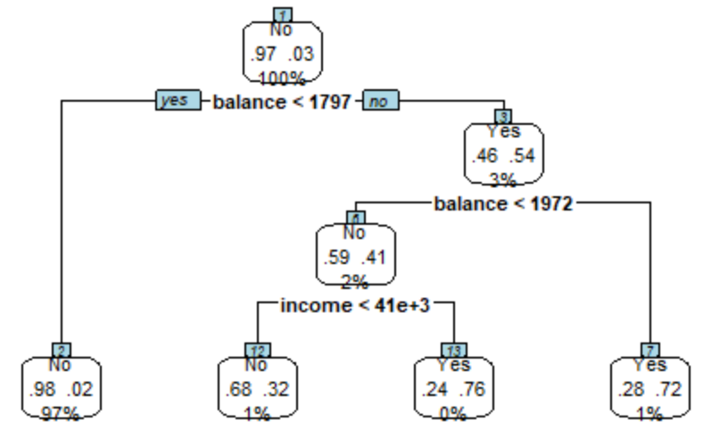
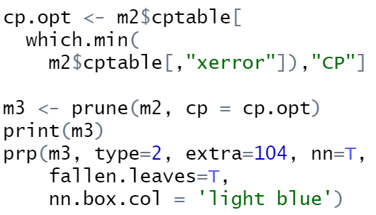
Model – Decision Tree in R
Modeling
We use the optimal cp to train the model:

Slide 20
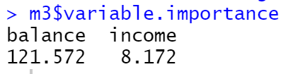
Model – Decision Tree in R
Modeling
We use the optimal cp to train the model and check the importance of each variable. The result shows the importance of ‘balance’ is much higher than ‘income’:

Slide 21
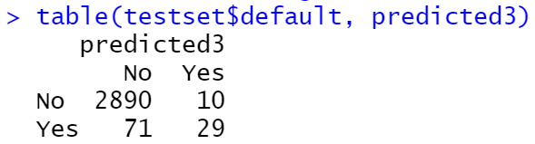

Model – Decision Tree in R
Evaluation
Test the model with testset and see the accuracy:

Slide 22
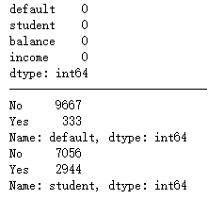
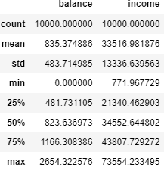
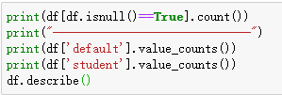
Model – Decision Tree in Python
Pre-processing
Before starting analysis and modeling, wrangling data by identifying if there is any missing value and checking if there is any wrong data by get a statistical summary of each column. (Or df.describe(include=“all”) )
It turns out that this data frame has no missing values and the values in four columns are normal (i.e.no negative numbers in column 'balance' and 'income'). Now we can define X, and y for our dataset.

Slide 23
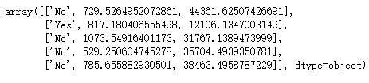


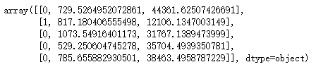
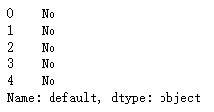

Model – Decision Tree in Python
Pre-processing
Using df as the LoanDefault.csv data read by pandas, declare the following variables:
X as the Feature Matrix (data)
y as the response vector (target)
Some features in this dataset are categorical such as 'student'. Since Sklearn Decision Trees do not handle categorical variables, we can convert these features to numerical values.
Now we can fill the target variable.

Slide 24
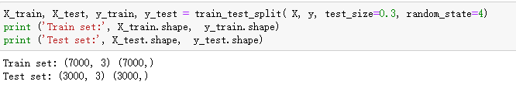
Model – Decision Tree in Python
Train Test Split
For our model having a high, out-of-sample accuracy, we use an evaluation approach called Train/Test Split. Our train_test_split will return 4 different parameters. We will name them: X_trainset, X_testset, y_trainset, y_testset.
The train_test_split will need the parameters: X, y, test_size=0.3, and random_state=4.
The X and y are the arrays required before the split, the test_size represents the ratio of the testing dataset, and the random_state ensures that we obtain the same splits.

Slide 25

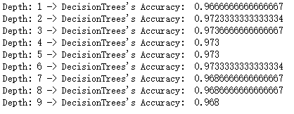
Model – Decision Tree in Python
Modeling
We will first create an instance of the DecisionTreeClassifier called ‘defaultTree’. Inside of the classifier, specify criterion="entropy" since here we are using ID3 function (For CART, please see appendices). Here I nest the model into loop statement to get the maximum accuracy of the tree size and get the optimal depth = 3.

Slide 26
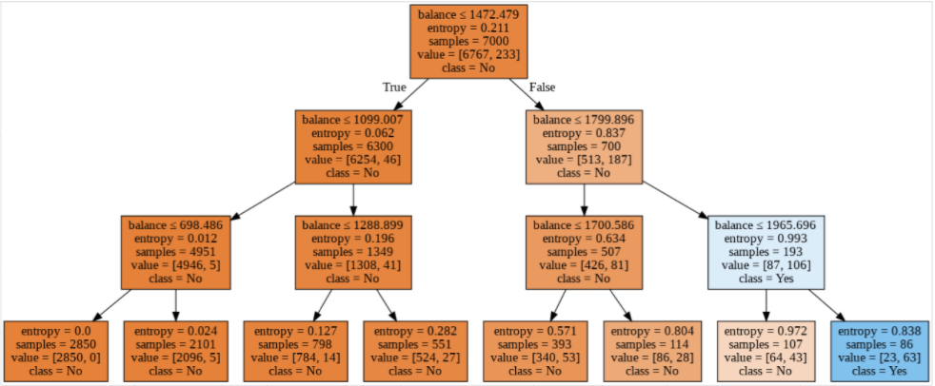
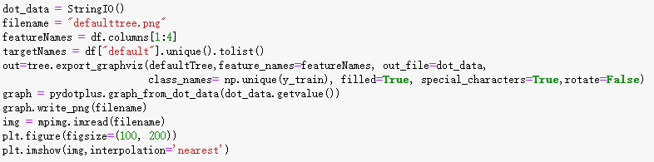
Model – Decision Tree in Python
Visualization

Slide 27
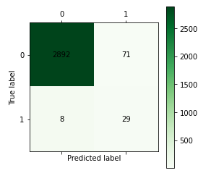
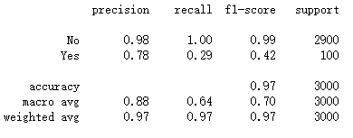
Model – Decision Tree in Python
Evaluation
Based on the count of each section, we can calculate precision and recall of each label:
Precision is a measure of the accuracy provided that a class label has been predicted. It is defined by: precision = TP / (TP + FP)
Recall is true positive rate. It is defined as: Recall = TP / (TP + FN)
So, we can calculate precision and recall of each class.
Notes:
The first row is for borrowers whose actual default value in test set is 0. As you can calculate, out of 3000 borrowers, the default value of 2963 of them is 0. And out of these 2963, the classifier correctly predicted 2892 of them as 0, and 71 of them as 1.
It means, for 2892 borrowers, the actual default value were 0 in test set, and classifier also correctly predicted those as 0. However, while the actual label of 71 borrowers were 0, the classifier predicted those as 1, which is a good job in predicting the borrowers with default value 0.
What about the borrowers with default value 1? Lets look at the second row. It looks like there were 37 borrowers whom their default value were 1. The classifier correctly predicted 29 of them as 1, and 8 of them wrongly as 1, which is not very good. We can consider it as error of the model for second row.
Based on the count of each section, we can calculate precision and recall of each label:
Precision is a measure of the accuracy provided that a class label has been predicted. It is defined by: precision = TP / (TP + FP)
Recall is true positive rate. It is defined as: Recall = TP / (TP + FN)
So, we can calculate precision and recall of each class.

Slide 28
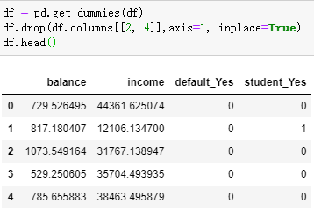
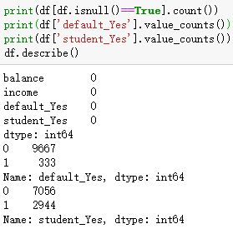
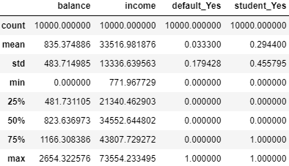
Model – Logistic Regression in Python
Pre-processing
As data frame shows, some features in this dataset are categorical such as 'student' or 'default'. We can convert these features to numerical values. pandas.get_dummies() Convert categorical variable into dummy/indicator variables and select useful features for modeling. Then wrangling data by identifying if there is any missing value and checking if there is any wrong data by get a statistical summary of each column. (Or df.describe(include=“all”) )

Slide 29






Model – Logistic Regression in Python
Pre-processing
It turns out that this dataframe has no missing values and the values in four columns are normal (i.e.no negative numbers in column 'balance' and 'income'). Now we can define X, and y for our dataset.
Also, we normalize the dataset:

Slide 30
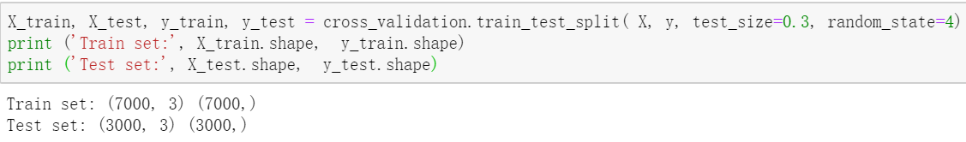
Model – Logistic Regression in Python
Train Test Split
Split the dataset into train and test set:

Slide 31
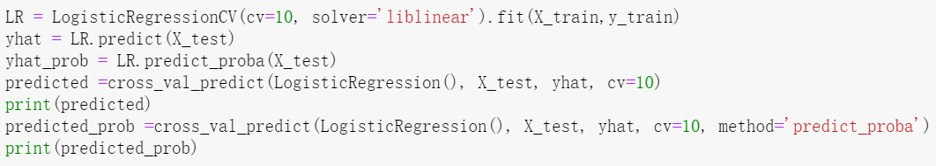
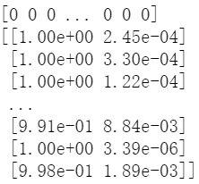
Model – Logistic Regression in Python
Modeling
Build our model using LogisticRegression from Scikit-learn package. This function implements logistic regression and can use different numerical optimizers to find parameters, including ‘newton-cg’, ‘lbfgs’, ‘liblinear’, ‘sag’, ‘saga’ solvers. Here the solver 'liblinear' is used due to the scale of the dataset. Now fit our model with train set:
predict_proba returns estimates for all classes, ordered by the label of classes. So, the first column is the probability of class 1, P(Y=1|X), and second column is probability of class 0, P(Y=0|X).

Slide 32

Model – Logistic Regression in Python
Modeling
Build our model using LogisticRegression from Scikit-learn package. This function implements logistic regression and can use different numerical optimizers to find parameters, including ‘newton-cg’, ‘lbfgs’, ‘liblinear’, ‘sag’, ‘saga’ solvers. Here the solver 'liblinear' is used due to the scale of the dataset. Now fit our model with train set:
predict_proba returns estimates for all classes, ordered by the label of classes. So, the first column is the probability of class 1, P(Y=1|X), and second column is probability of class 0, P(Y=0|X).

Slide 33
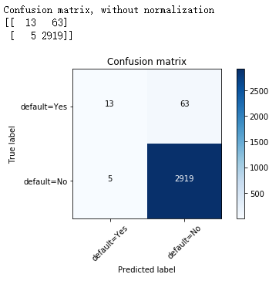
Model – Logistic Regression in Python
Evaluation
Here we can see when the threshold is not set, it is the default value = 0.5. The first row is for borrowers whose actual default value in test set is 1. As you can calculate, out of 3000 borrowers, the default value of 76 of them is 1. And out of these 76, the classifier correctly predicted 1 of them as 1, and 75 of them as 0.
It means, for 1 borrowers, the actual default value were 1 in test set, and classifier also correctly predicted those as 1. However, while the actual label of 75 borrowers were 1, the classifier predicted those as 0, which is not very good. We can consider it as error of the model for first row.
What about the borrowers with default value 0? Lets look at the second row. It looks like there were 2924 borrowers whom their default value were 0. The classifier correctly predicted 2924 of them as 0, and none of them wrongly as 1. So, it has done a good job in predicting the borrowers with default value 0.

Slide 34
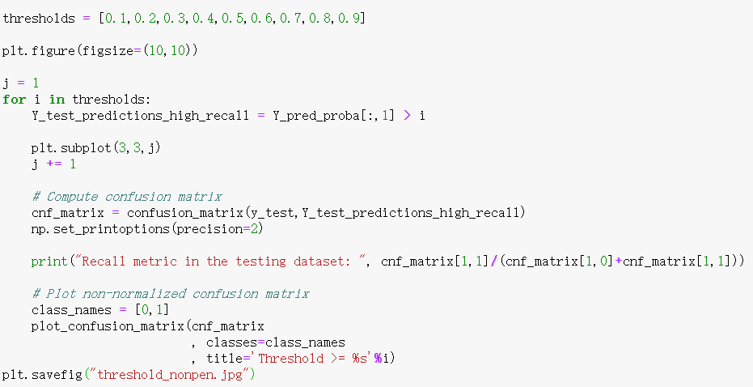
Model – Logistic Regression in Python
Modeling
The calculation above demonstrated a normal logistic regression modeling process, which is based on a default threshold: 0.5. However, our target is to block borrowers who cannot repay the loan rather than losing potential clients. Now we do this by adjusting the threshold. Here I illustrate all confusion matrices with threshold from 0.1 to 0.9.

Slide 35
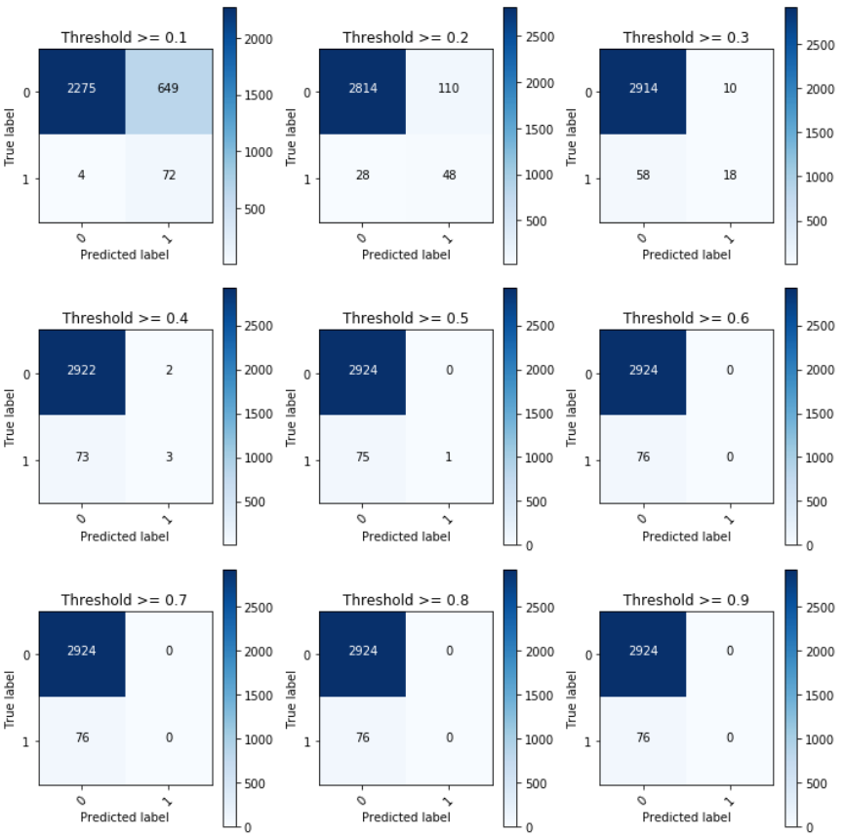
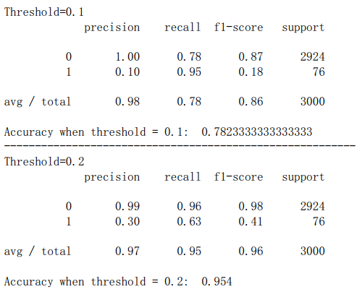
Model – Logistic Regression in Python
Evaluation
Notes:
Based on the count of each section, we can calculate precision and recall of each label:
Precision is a measure of the accuracy provided that a class label has been predicted. It is defined by: precision = TP / (TP + FP)
Recall is true positive rate. It is defined as: Recall = TP / (TP + FN)
So, we can calculate precision and recall of each class.

Slide 36
Model – Logistic Regression in Python
Evaluation
In dealing with larger dataset, we can add a paremeter penalty = 'l2' in LogisticRegression() and also apply cross validation, which is used to avoid overfits to improve the generalization of functions (see in appendices).
Notes:
Based on the count of each section, we can calculate precision and recall of each label:
Precision is a measure of the accuracy provided that a class label has been predicted. It is defined by: precision = TP / (TP + FP)
Recall is true positive rate. It is defined as: Recall = TP / (TP + FN)
So, we can calculate precision and recall of each class.

Slide 37
Result
Through decision tree model, we can clearly see the criterion of categories, which is mainly depends on the balance deposited in the bank, the accuracy of the model is 97.3% - 97.37% with a default rate of 0.28%.
Logistic regression performs better accuracy than decision tree in this data set. Through logistic regression model, when we set a strict threshold to 0.2, the accuracy of the model is 95.4% - 97.53% with a default rate of 0.99%. Compare to the threshold 0.1, where the accuracy is 78.23%, the 0.2-threshold model performs more accurately. However, with a more strict threshold, the default rate can be decreased to 0.18%.

Slide 38
Discussion
From this report, the decision tree model presents better balance between accuracy and comprehensibility. However, the decision tree model is less quantifiable than the logistic regression model because it is classified by splitting the dataset into nodes. Logistic regression, on the other hand, performs better in numerical conversion (possibilities).
In terms of the different fiscal policies adopted at different times, in the context of tight fiscal policy, the use of a model with a threshold of 0.1 can reduce loan risk. Under loose fiscal policy, using a model with a threshold of 0.2 can reduce the number of FN, thereby increasing profitability while reducing risk. Given the different characteristics of the two models, it is recommended to apply separately for complementing.
In evaluation, for avoiding overfitting and improve the generalization of functions, commonly adding a parameter penalty = ‘l1' in LogisticRegression() and applying corss-validation (K-folds in this report) are general operations. However, we found that the operations above are inapplicable. One possible reason is the data set. As result of data checking shows, a mere 333 samples have a default out of 10000, which may insufficient to form a valid classifier. This is hypothetically a limitation which needs to be further investigated.

Slide 39
Conclusion
In this report, we built decision tree and logistic regression models based on loan user data with a sample size of 10,000. Taking into account the different language environments of lenders own, the R language and Python language are used respectively, and the model accuracy rate reaches 97.37%. This report sets thresholds to realize the adjustment of models under different fiscal policies. As the sample size of loan default users increases, the accuracy of the model can be further optimized.

Slide 40
References
[1] J. M. Goldberg, CFA and M. C. DeVries, “Credit Card Master Trust: Pace of delinquency,” Barclays Equity Research, vol. 10, pp. 1-8, 2017.
[2] J. Pomeroy, “The booming digital Economy: The pandemic accelerates the megatrend,” HSBC Economics Global, vol. 9, pp. 27, 2020.
[3] G. Legorano, “For Italy, Opportunity Knocks,” The Wall Street Journal, para.1, September 14, 2020.
[4] P. Berger, “Firm Forgives $70 Million in Taxi Debt,” The Wall Street Journal, para.1, September 14, 2020.
[5] H. M. Mueller and C. Yannelis, "The rise in student loan defaults," Journal of Financial Economics, vol. 131, no. 1, pp. 1–19, 2019.
[6] G. Vayas-Ortega, C. Soguero-Ruiz, M. Rodr ́ıguez-Ib ́a ̃nez, J.-L. Rojo- ́Alvarez, and F.-J. Gimeno-Blanes, "On the differential analysis of enter-prise valuation methods as a guideline for unlisted companies assessment(ii): Applying machine-learning techniques for unbiased enterprise value as-sessment, " Applied Sciences, vol. 10, no. 15, p. 5334, 2020.
[7] L. Abid, A. Masmoudi, and S. Zouari-Ghorbel, "The consumer loan’s pay-ment default predictive model: an application of the logistic regression and the discriminant analysis in a tunisian commercial bank, " Journal of the Knowledge Economy, vol. 9, no. 3, pp. 948–962, 2018.
[8] L. Breiman, J. Friedman, C. Stone and R. Olshen, Classification and Regression Trees; CRC Press: Boca Raton, FL, USA, 1984.
[9] G. Moisen, “Classification and regression trees,” Encycl. Ecol. 2008, 1, 582–588.
[10] 王晨阳, “基于决策树算法的审计数据分析研究”, 会计之友, vol.13. 2020, pp. 139-143.

Slide 41
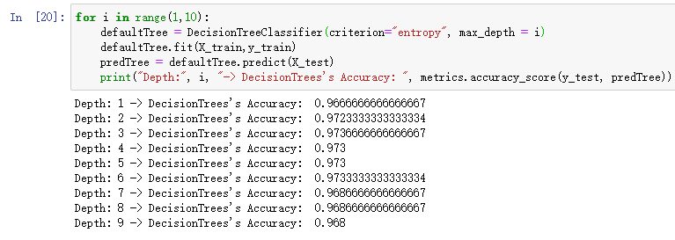
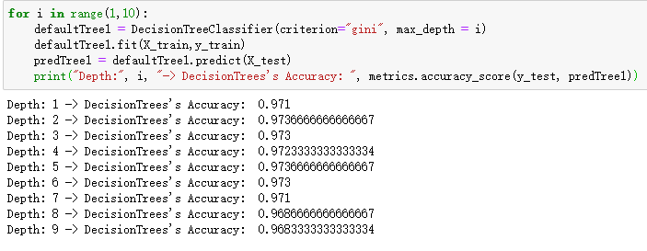
Appendix I
The comparison between ID3 and CART:

Slide 42
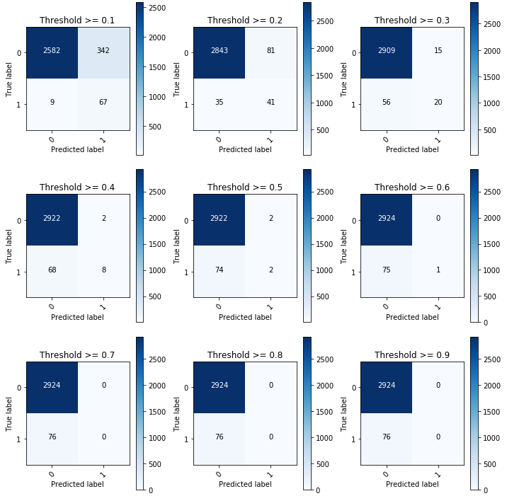
Appendix II
Penalty ”l1”:

Slide 43
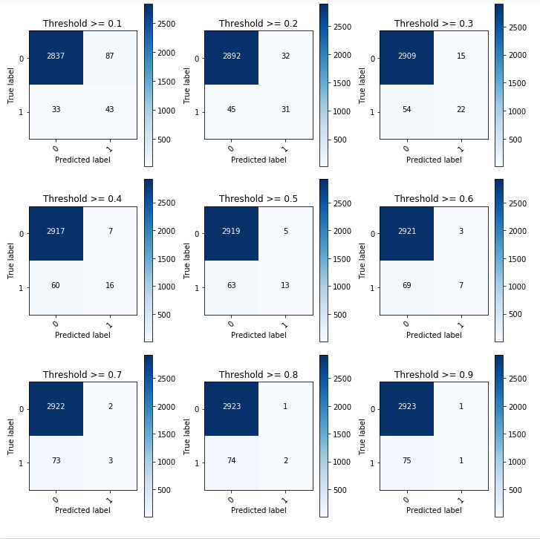
Appendix III
10-folds cross-validation:

Slide 44

Thank you!

